Slide 1
Paint mini-project
Tien Duc: Tools for drawing on canvas, undo/redo, file operations
Tri Hung: Design GUI
Viet Hoang: Set initialization
OOLT.ICT.20192.Group8
Member assignment

Slide 2
Problem statements
Draw a shape (rectangle, circle, ellipse,…) or a line with the corresponding tools.
Use pencil and brush to create custom draw-lines.
Select color for the outline and filling.
Select the size of the outline.
Erase a drawing.
Create a new file (new drawing space), open an existing file, save the current file.
Undo/Redo a drawing.

Slide 3
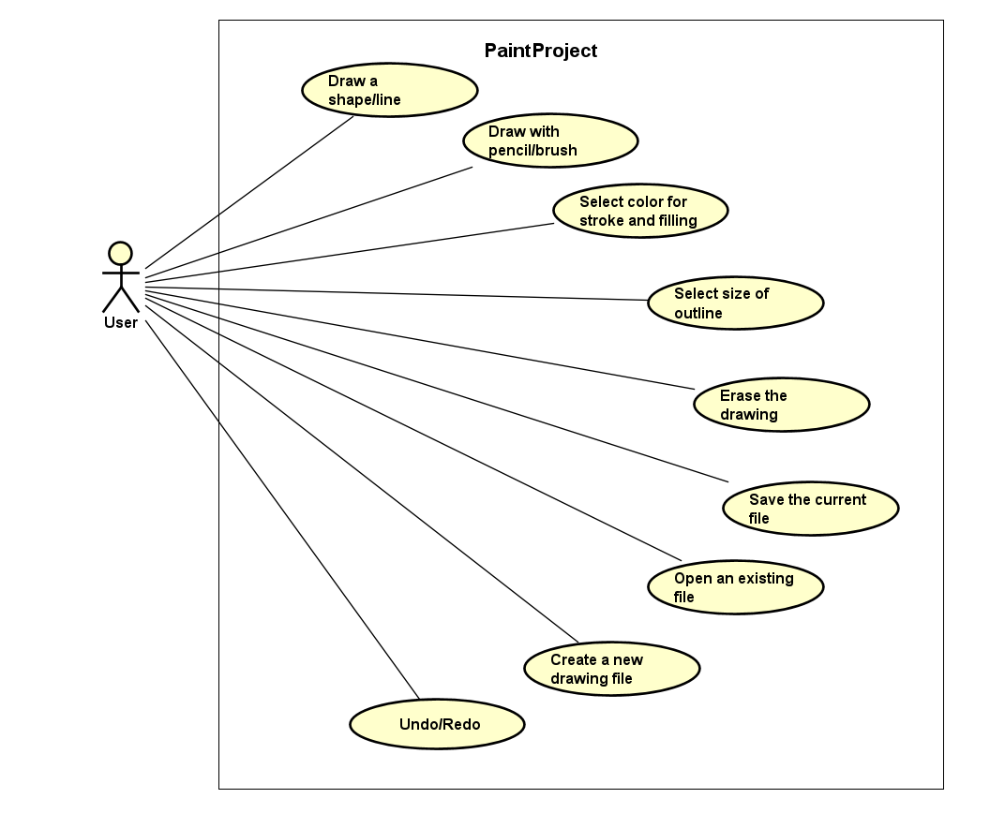
Use-case diagram
Paint mini-project

Slide 4
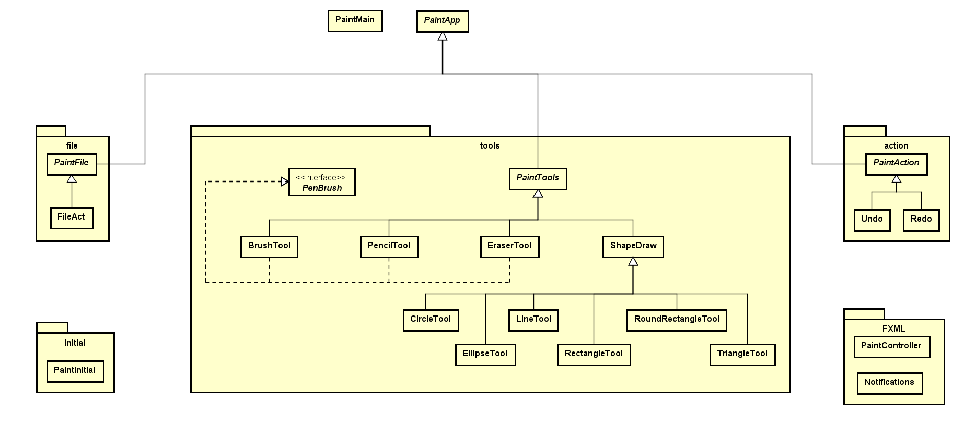
Class diagram
General overview

Slide 5
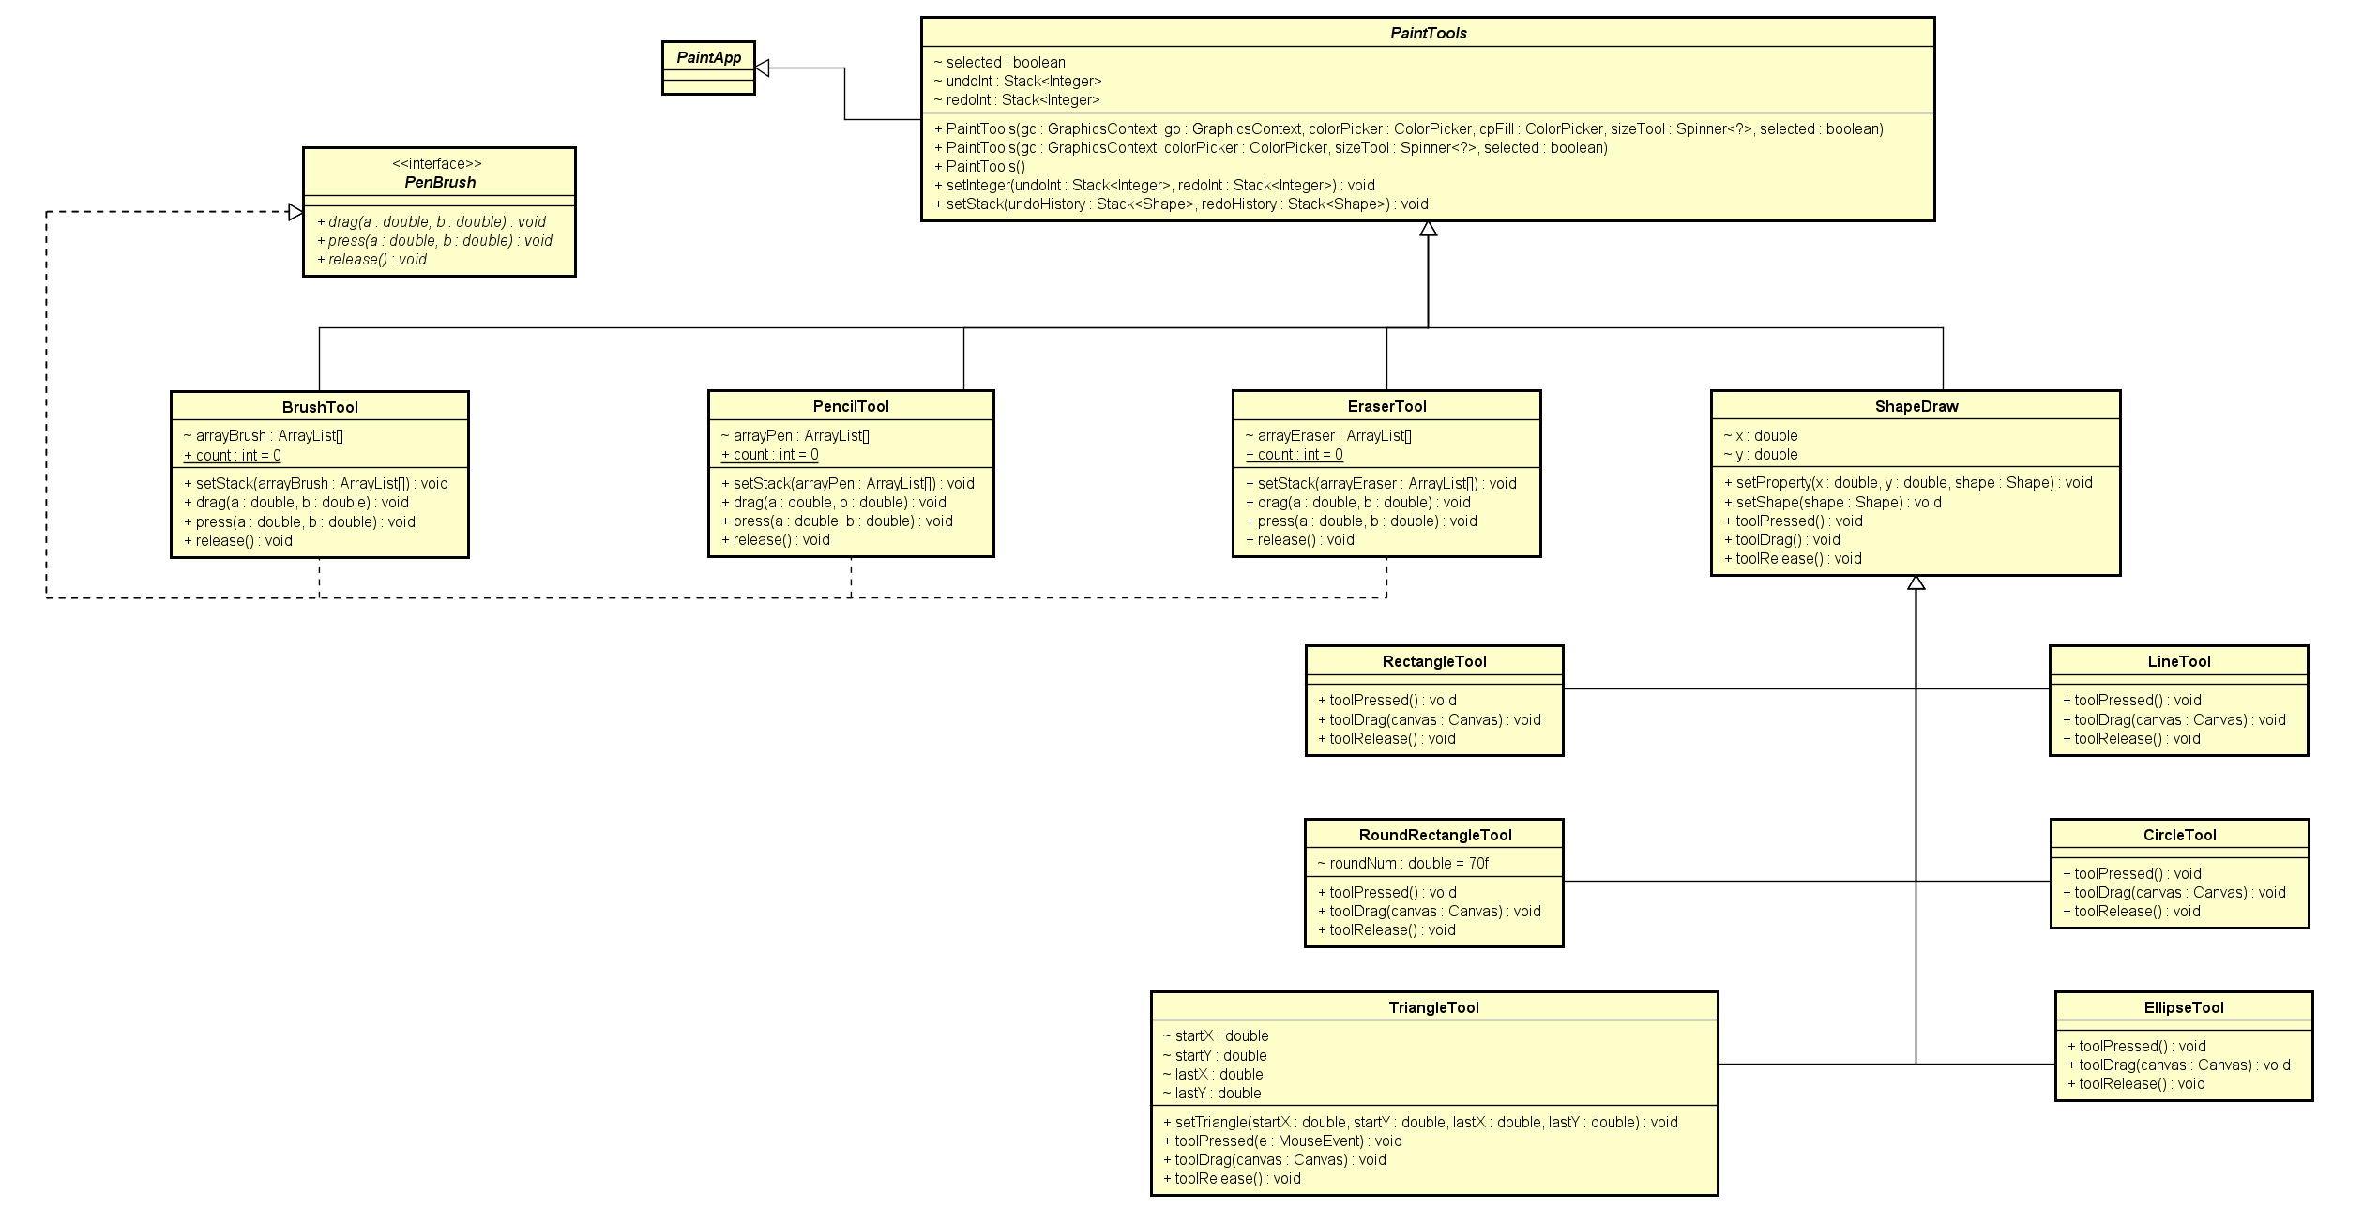
Class diagram
In package paint.tools

Slide 6
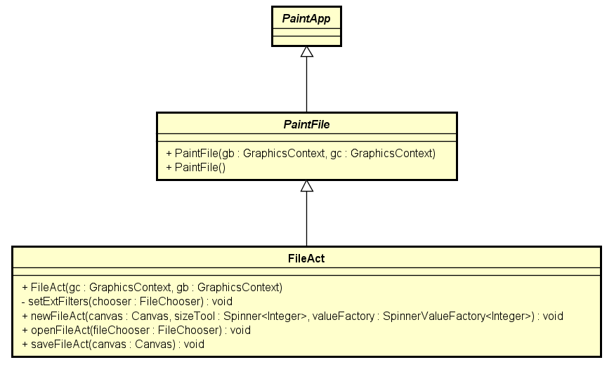
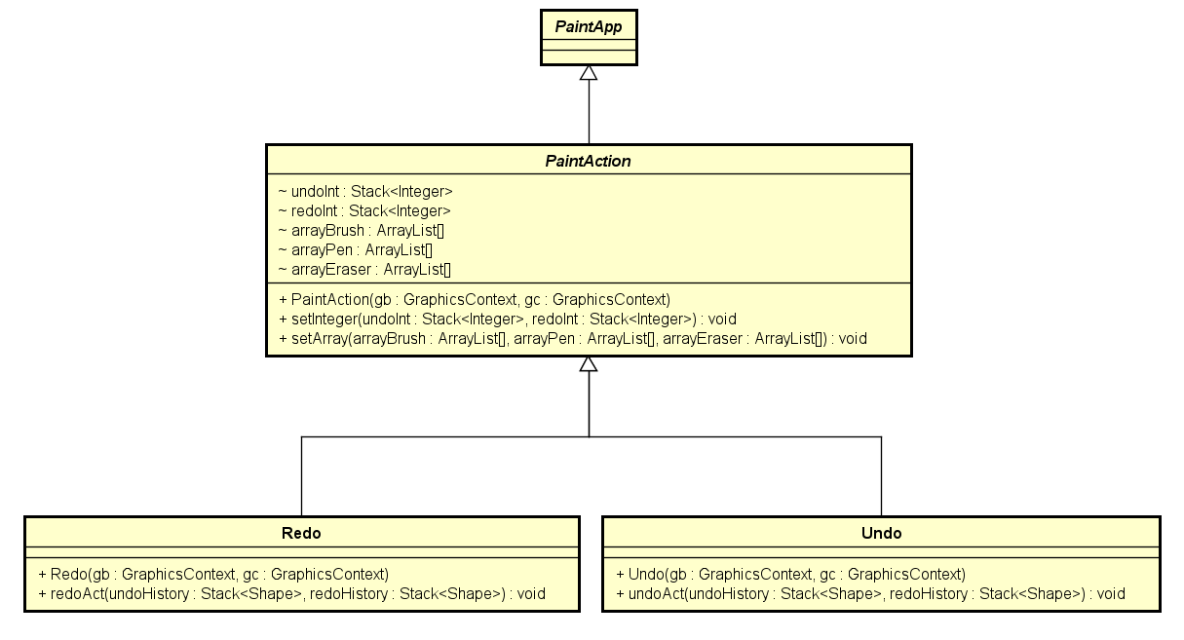
Class diagram
In packages paint.file and paint.action

Slide 7
Application demonstration
Paint mini-project | OOLT.ICT.20192.Group8

